Slide 1
WEF Member Associations Strategic Planning & Goal Setting Do-it-Yourself Template
WEF Member Associations
Strategic Planning & Goal Setting Do-it-Yourself Template

Slide 2
WEF Member Associations Strategic Planning & Goal Setting Do-it-Yourself Template
Courtesy of Water Environment Federation
by Linda Kelly

Slide 3
Strategic Planning is a Member Association’s process of defining its strategy and direction, and making decisions on allocating its resources to pursue this strategy
What do your members expect/need?
What does your MA need to do to meet these expectations?
How does your MA do best?
Where do you want the MA to be in 3-5 years?

Slide 4
Suggestions for Process
Utilize someone familiar with strategic planning to facilitate…doesn’t necessarily have to be a third party, but primary role should be the process and not participation
Use a smaller group/team (9-11) of diverse members to do the assessment, then report back to the larger group
Set regular meetings (monthly) and a reasonable timeframe to complete (6 months – 1 year)

Slide 5
Overview – Planning for Strategic Change
Identify the purpose
Establish a Vision Statement
Select Goals
Identify approaches or strategies
Identify action plans to implement each strategy
Compile the mission, vision, strategies and action plans into a document
Create performance metrics
Monitor implementation of the Plan and update as needed

Slide 6
How it fits together
Where we need to be in the future
Vision
Why we exist
Mission
What we believe
Standards of conduct
Values
Things we must do
Goals
How/when we will do them
Objectives
Monitoring success
Measures

Slide 7
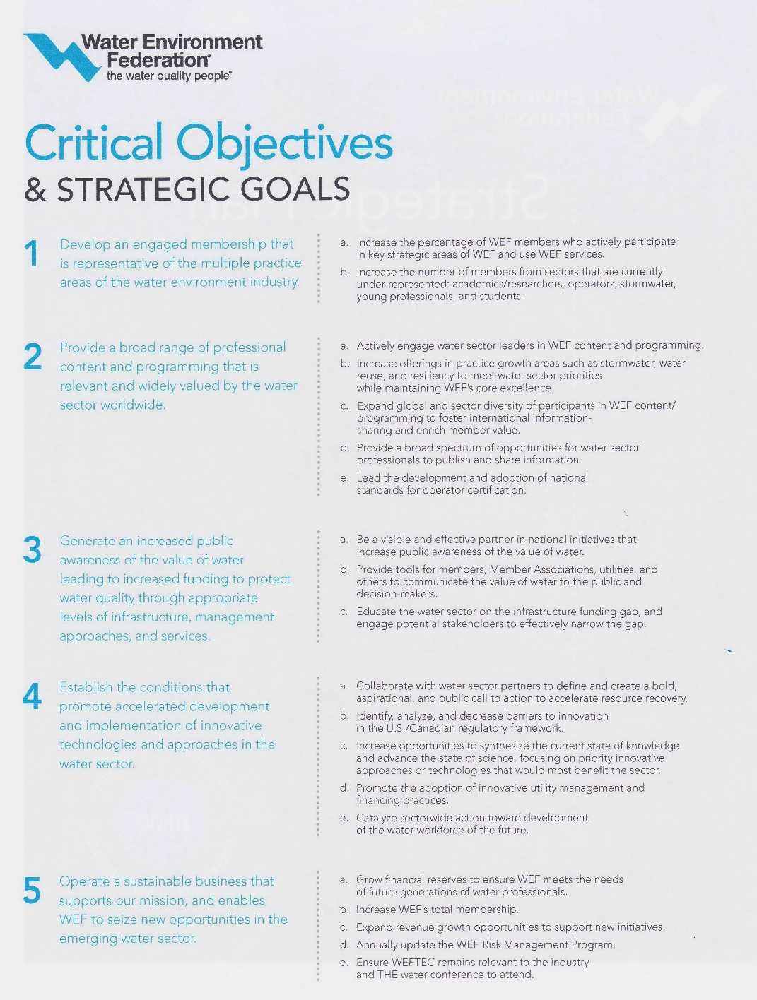
WEF’s Strategic Plan (as example)

Slide 8
Establish Values
What the organization believes & values
How the organization will behave

Slide 9
Establish Values
(Example courtesy of Rocky Mountain WEA)
Core Values are what support our vision and mission; they shape our culture, and reflect who RMWEA is and how we operate
Mission Statement is our "purpose in action"; it's what we do every day to achieve our vision with direction from our values
Vision Statement is what RMWEA aspires to be; it helps drive decisions, focus goals, and is our overarching purpose in everything we do
Vision
Mission
Values

Slide 10
Establish a Vision Statement
A vision statement is the inspiration and the framework for all of your strategic planning
It is what your MA aspires to be in the future
(Examples here)

Slide 11
Establish a Mission
A mission statement is why the organization exists
(Examples here)

Slide 12
Select Goals
General statements about what you need to accomplish to meet your purpose, or mission, and address major issues facing the organization
(Examples here)

Slide 13
From your general goals, create specific objectives under each one (consider the SMART attributes as you develop the specific objectives)
Goal:
To make WEF Highlights the most effective and efficient member communication channel.
Objective:
Increase Highlights average monthly readership by 10% between Jan. 1 and July 30, 2014.

Slide 14
When thinking of SMART Objectives:
Specific
Bad Example: Increase participation of members.
Good Example: Increase attendance at annual conference by XX.
Measurable
Bad Example: More members will attend…
Good Example: 80% of members will attend annual conference.
Attainable
Bad Example: 100% of members will attend every meeting.
Good Example: Increase attendance at annual conference by 10% from the prior year.
Relevant
Bad Example: Teach all members to make a great pizza.
Good Example: Ensure the highest quality water reuse training is available to members by xxx.
Time-Oriented
Bad Example: Winter
Good Example: January 30, 2017

Slide 15
Identify Goals
Goals are things the MA must do to be successful

Slide 16
Identify Objectives for Each Goal
Objectives are ‘how’ and ‘when’ you will accomplish the goals
Objectives are very specific and should include SMART attributes (Specific, Measurable, Attainable, Relevant, Time bound)

Slide 17
Identify Action Plans & Performance Metrics to implement each objective
Specific activities that the leadership or assigned ‘champion’ must undertake
Must have Performance Metric to know if you’ve met the objective

Slide 18
Compile the Mission, Vision, Strategies and Action Plans
Create a strategic plan document that guides the organization for 3-5 years

Slide 19
Western Canada Water Environment Association
(Example courtesy of Western Canada WEA)
Strategic Plan - Work Plan
Vision
Preserve and enhance the water environment through the professional growth of our members.
Mission
Connect water professionals and leverage knowledge to champion clean and safe water in Western Canada.
Core Values
Through our volunteer efforts, we ascribe to the guiding principles of
leadership, stewardship and fellowship as we follow our core values:
Inclusive
Member Service
Collaborative
Innovative
Strategic Intention: Member Engagement
Goals | Objectives | Action Plans & Metrics | Leader
Goal #1: Increase Membership | Objective 1a: Maintain current membership, and increase individual memberships by 20 new members by end of 2018 by utilizing WEF’s new membership recruitment strategy. | Identify dropped members over last two years by end Feb 2017 using existing database of WCW | Audrey
 |  | Break up list and distribute by region to Board members at March 2017 Board meeting | Board
 |  | Perform exit interviews between March-Dec 2017 | Board
 |  | “Planner” to connect with WEF Delegate, who will contact WEF office, to determine what resources are available to support event | Planner
 |  | Receive, review and present WEF recruitment strategy to Board as per WEF schedule | Jeff
 |  | Customize WEF recruitment strategy at 2018 Planning Meeting | Board
 |  | 20% new members by end of 2018 | Board
 | Objective 1b: Enhance communication to existing and potential members through creation and dissemination of a messaging package dedicated to the value received through membership. | Obtain WEF membership materials that communicate value by Feb 2017 | Jeff
 |  | Analyze material and determine if it can be used as is, or if it needs to be revised by Aug 2017 | Jeff
 |  | Create materials and decide how to disseminate info at 2017 WCW conference | Board

